Slide 1
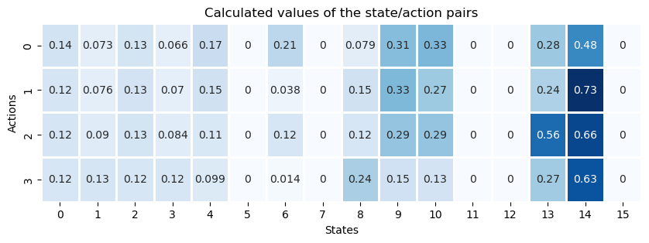
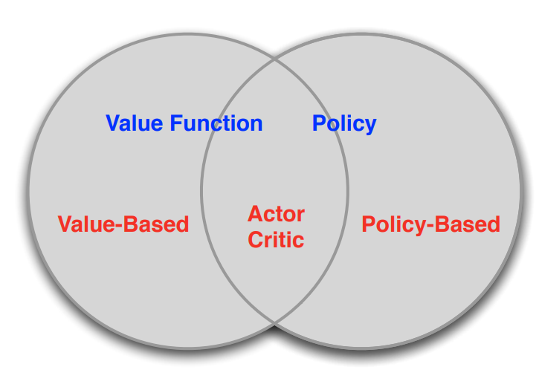
Value vs. Policy Learning
Value Learning
No explicit policy is stored, only a value function. The policy is implicit and can be derived directly from the value function (pick the action with the best value).
→ Output: State or State/Action Values
e.g. Tabular Q-Learning
Policy Gradient Learning
An explicit representation of a policy is built, mapping states to actions.
→ Output: Probabilities
e.g. Actor-Critic

Slide 2
Value vs. Policy Learning
Advantages of Policy Learning
Disadvantages of Policy Learning
Easy to extend to high-dimensional or continuous action spaces
Can learn stochastic policies
Exploration is provided by stochastic policy
Change in network weights changes the probability output only a little (contrast: Q-Learning, a new action might have the new best value, which is more volatile)
Could get stuck in local optima
Does not necessarily extract all information from the data when used in isolation (Source: Deepmind)

Slide 3
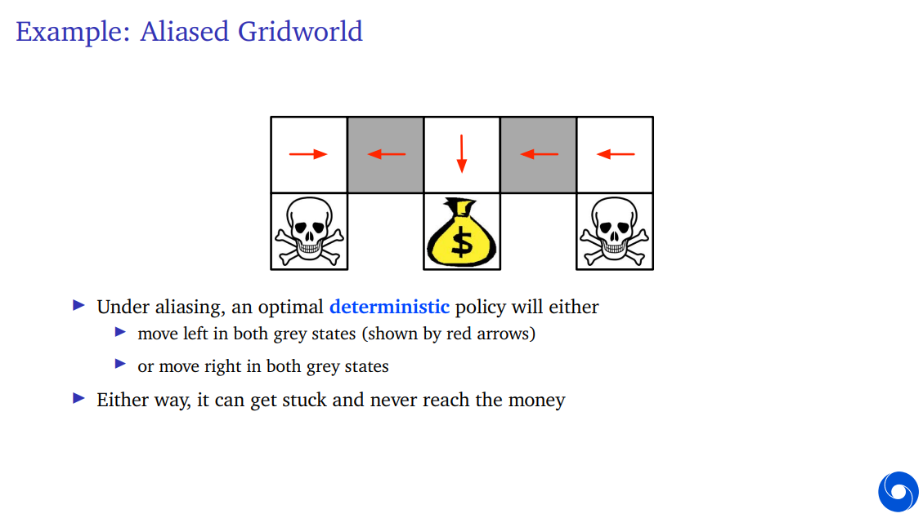
Stochastic vs. Deterministic Policies
Source: Deepmind RL Lecture Series 2021

Slide 4
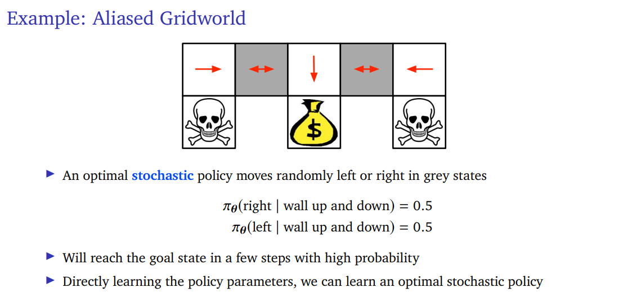
Stochastic vs. Deterministic Policies
Source: Deepmind RL Lecture Series 2021

Slide 5
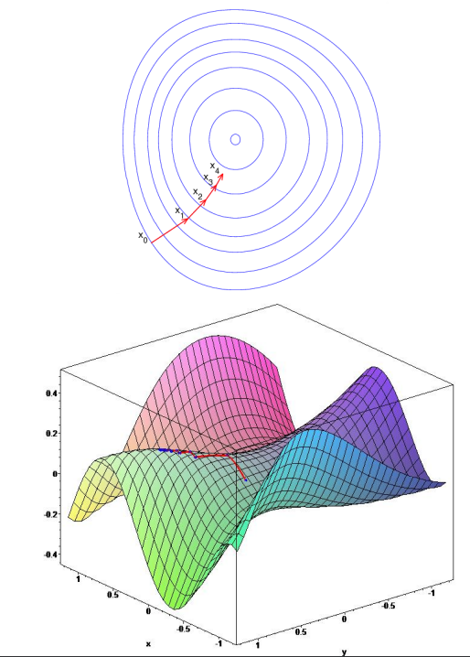
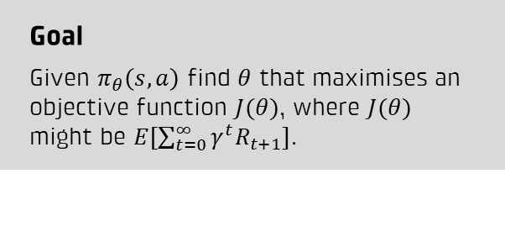
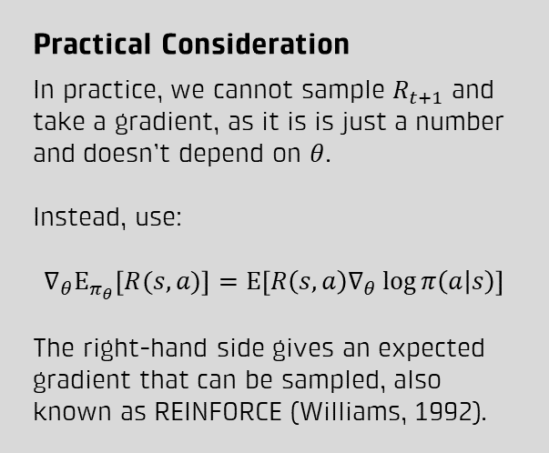
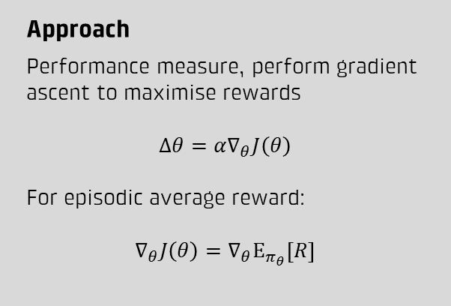
Policy Gradient Method
Goal
Given $π_{θ}\left(s,a\right)$ find $θ$ that maximises an objective function $J(θ)$, where $J(θ)$ might be $E[\sum_{t=0}^{∞}{γ^{t}R_{t+1}}]$.
Practical Consideration
In practice, we cannot sample $R_{t+1}$ and take a gradient, as it is is just a number and doesn’t depend on $θ$.
Instead, use:
$$∇_{θ}Ε_{π_{θ}}\left[R(s,a)\right]=Ε\left[R\left(s,a\right)∇_{θ}\log{π\left(a | s\right)}\right]$$
The right-hand side gives an expected gradient that can be sampled, also known as REINFORCE (Williams, 1992).
Approach
Performance measure, perform gradient ascent to maximise rewards
$$Δθ=α∇_{θ}J\left(θ\right)$$
For episodic average reward:
$$∇_{θ}J\left(θ\right)=∇_{θ}Ε_{π_{θ}}\left[R\right]$$
Intuition
Increase the probability of actions with high rewards and vice-versa.

Slide 6
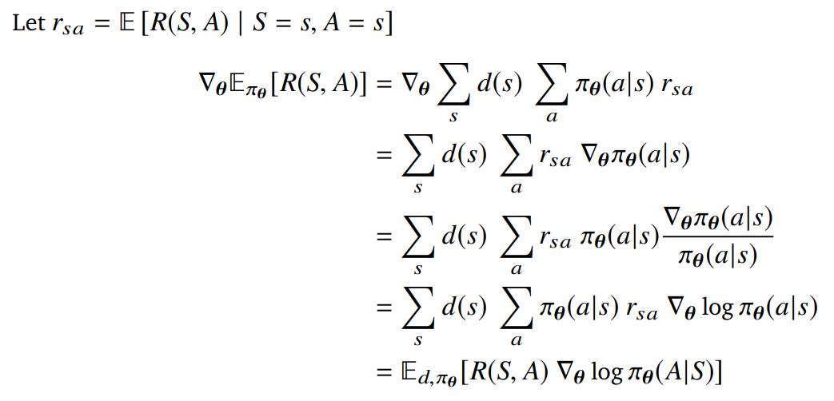
Proof: The Score-Function Trick
Source: Deepmind RL Lecture Series 2021

Slide 7


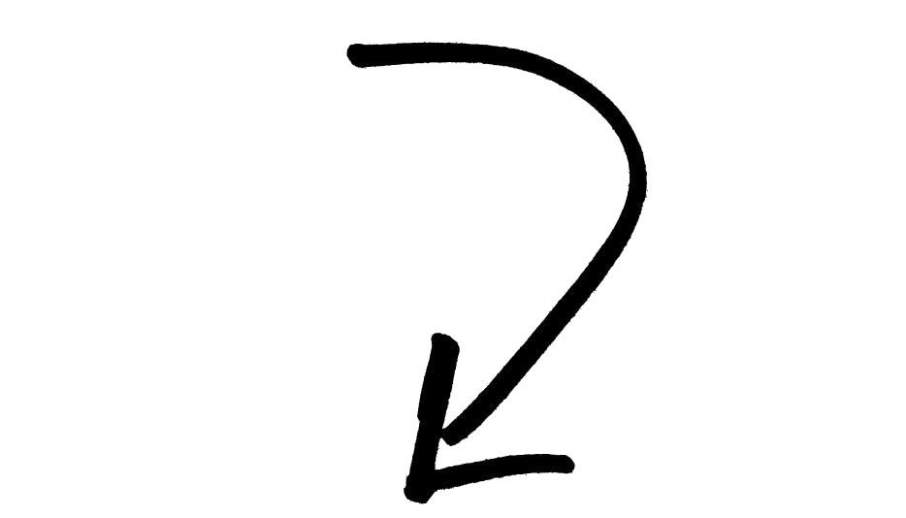

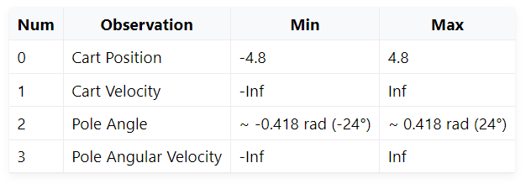

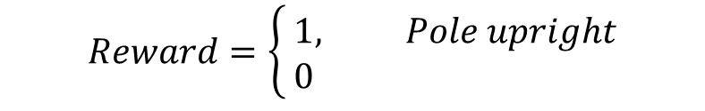
Beispiel: Cartpole
Agent
Reinforcement Learning Kontext
Jeder Timestep:
Observation
Action
Reward
Actions
$$[left, right]$$
Observations
$$Reward=\left\{ \begin{aligned}&1, Pole upright \\ &0 \end{aligned}\right.$$

Slide 8
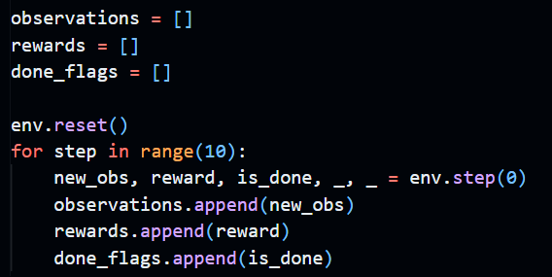
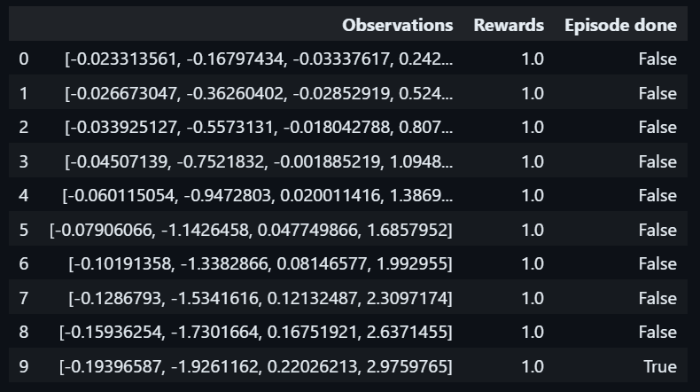
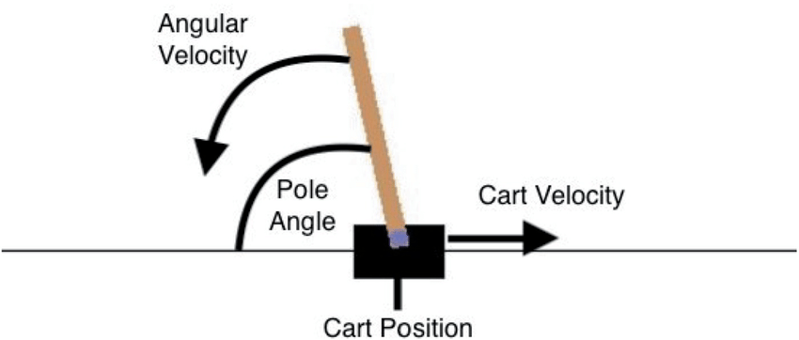

Beispiel: Cartpole
10 Steps: Immer links
Steuerung des Agenten in Python:
$$[left]$$

Slide 9

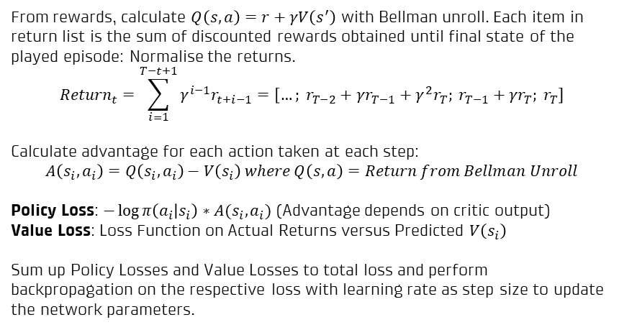
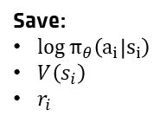



A2C
Episodic Training
Initialise Env
Policy Head
(Actor)
$$π_{θ}\left({a_{0}|s}_{i}\right)=0.2$$
$$π_{θ}\left({a_{1}|s}_{i}\right)=0.8$$
Sample Action
$$a_{i}∼π_{θ}$$
Common Net
(Body)
$$State_{i}$$
Step
Value Head
(Critic)
$$V\left(s\right)$$
Check
AVG Reward > Criterion
Environment
True: Break
Backpropagation Logic
Step | Log Prob | State Value | Step Rewards
1 | … | … | …
2 | … | … | …
… | … | … | …
T | … | … | …
From rewards, calculate $Q\left(s,a\right)=r+γV\left(s^{′}\right)$ with Bellman unroll. Each item in return list is the sum of discounted rewards obtained until final state of the played episode: Normalise the returns.
$$Return_{t}=\sum_{i=1}^{T−t+1}{γ^{i−1}r_{t+i−1}}=\left[…; r_{T−2}+γr_{T−1}+γ^{2}r_{T}; r_{T−1}+γr_{T}; r_{T}\right]$$
Calculate advantage for each action taken at each step:
$$A\left(s_{i},a_{i}\right)=Q\left(s_{i},a_{i}\right)−V\left(s_{i}\right) where Q\left(s,a\right)=Return from Bellman Unroll$$
Policy Loss: $−\log{π\left(a_{i} | s_{i}\right)}∗A(s_{i},a_{i})$ (Advantage depends on critic output)
Value Loss: Loss Function on Actual Returns versus Predicted $V\left(s_{i}\right)$
Sum up Policy Losses and Value Losses to total loss and perform backpropagation on the respective loss with learning rate as step size to update the network parameters.
Save:
$\log{π_{θ}\left(a_{i} | s_{i}\right)}$
$V\left(s_{i}\right)$
$r_{i}$
Pull and clear
Check
Episode Terminated
Initialise New Episode
TRUE
Backprop
FALSE
Repeat

Slide 10
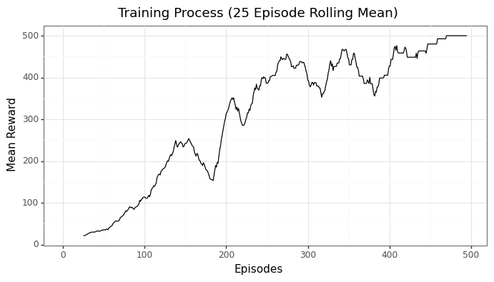
DQN - Resultat
Train until criterion is reached
CartPole:
Average reward (50 last episodes) >= 475

